Slide 1




D&A offerings and Questionnaire
D&A Technology
Information Classification − Internal

Slide 2

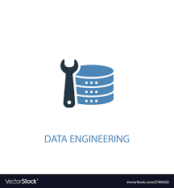
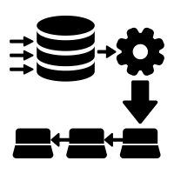
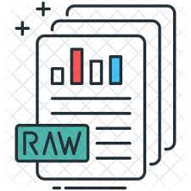
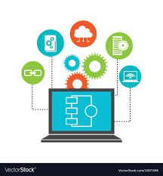
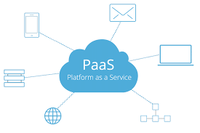
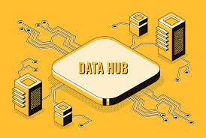
Commonly used D&A Offerings
Realisation of the OneBank vision requires coordination of data architectural outcomes across the entire bank. D&A have defined key outcomes that will drive other areas of the bank towards the strategic target
Platform As a Service
D&A offers platform as a service to business.We help business carry out
their solutions by providing them consultancy and platform to implement
solutions.
Reference and data management
AI/ML
Data Engineering
Data ingest
Reporting
Customer decisioning
Enterprise data Hub
The Enterprise Data Hub is the entity that covers all of the strategic Data & Analytics platforms (Teradata, Hadoop etc.) of the bank
EDI– ETL capability on commonly required data in enterprise for reporting and analytics use cases.
Raw Data zone– capability to store data from operation source systems unchanged so that analytics can be performed without impacting the operational systems
Operational zone– capability to expose data in edh to on demand service calls using low latency online stores
Shared Zone-Ability to automate the analytics processes and host the resultant datasets for onward consumption by users or systems
Discovery Zone-Ability to explore and experiment with analytical processes on production data(Playpens & sandboxes)
Data access interface-Ability for end users to consume data within EDH and publish results of their analysis back to edh
2

Slide 3



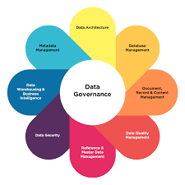




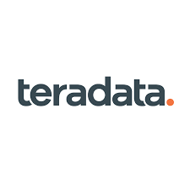






Common Services/Tools used by D&A Patterns
We encourage self service using
own ETL tooling for data
ingestion and egress
Data Ingestion
Data management & governance
Kafka
EDI
Party/mdm
Registry
IDQ
Ref Data
Data Storage
EDW/Teradata
Bigdata/Hadoop
ODS/mongoDb
S3
Snowflake
Data Processing
Reporting
Stream sets
Informatica BDM
Self-service
SAS
Business Objects
Tableau
Thoughtspot
Post q2 we would be migrating to
cloud
If building solutions on premise ,
Tenants need to
consider migration to cloud

Slide 4





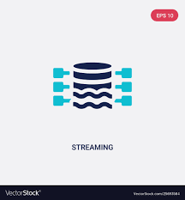
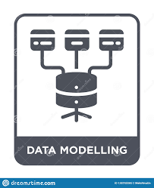

Questionnaire-use cases supported
Future evolutions
Note:These requests currently not supported from ask archie,drop a mail to engagement group for such use cases
Mail to :Engagement group : ( ~ DAT_BusinessEngagement FM-032571@rbos.co.uk)
Common use cases supported
New data sourcing in D&A
Build data extracts from data lake
New Reporting use case on D&A data lake
Data Analysis for existing DNA data? Link to EDH portal, highly encourage you to reach out to SPOKEs. EDH Data Portal - Home (rbsres01.net)
Future Evolution
Data science\Real time data sourcing
Data modelling
Data archiving

Slide 5




Questions to expect in Questionnaire
General
Data
Did you engage with business spokes?
SLA’s
Do you have any functional/Data flow diagram to be shared
Batch/Streaming
Target system
Any dependency with other systems?
Pivot or full scale?
Which Department?
Are data sources Golden source systems?
Master and Golden Sources (rbsres01.net)
Is there a requirement for historic data?
How many tables/attributes?
If any source external to NWG?
Volume of data
Services
Non Functional Requirements
Services
Have you evaluated CIA rating?
https://confluence.dts.fm.rbsgrp.net/display/EDG/CIA+summary
Have you evaluated PIA score for your application?
https://intranet.rbsres01.net/Legal/PrivacyandClientConfidentiality/Pages/default.aspx
Which tier your application belongs to?
Do you know RTO/RPO for your application
Security requirement
Managed or self service?
Did you validate if your data is in EDH Data portal
EDH Data Portal - Home (rbsres01.net)
Did you engage with business spokes?
Describe your Use case-
data extract/data sourcing/data analysis/reporting

Slide 6




OR
Are you ready to take the questionnaire?
For any other support drop a mail to D&A engagement group (~ DAT_BusinessEngagement <FM-032571@rbos.co.uk)

